Slide 1

Open Materials, Data and Code
Part of the workshop series on Open Science practices.
Emily Godwin, Johnny Swierczynski, Darja Wischerath
Notes:
Should we start with the icebreaker activity here?

Slide 2

Ice Breaker Activity
Draw a triangle
Draw an upside-down triangle on top of the first triangle
Draw a large circle
Draw 8 small triangles equidistant to the circumference of the circle
Draw a long upside-down ‘U’ shape
Draw a line across the opening of the ‘U’ shape
Draw 3 parallel vertical lines underneath the final line

Slide 3
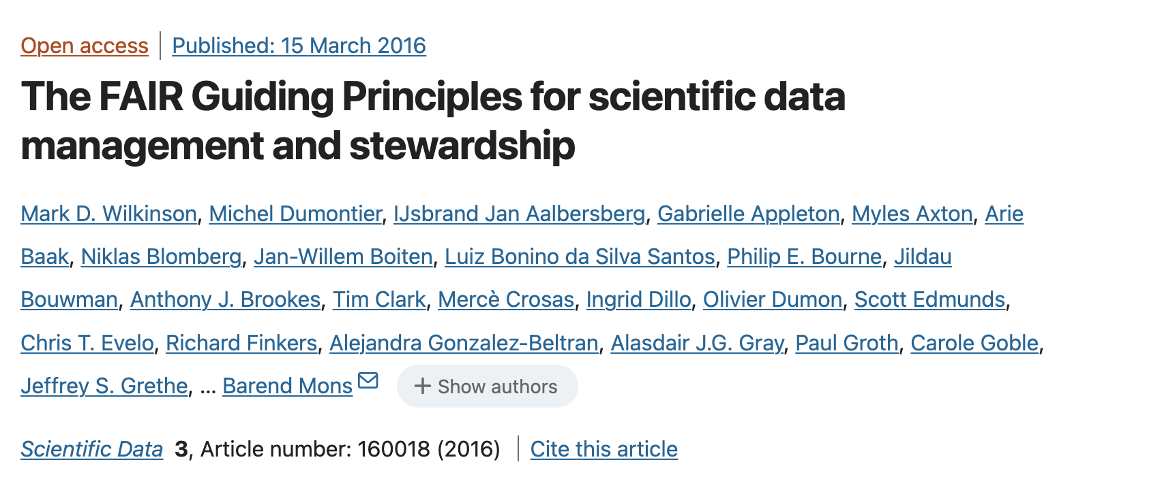
FAIR Principles
Findability
Accessibility
Interoperability
Reproducibility

Slide 4
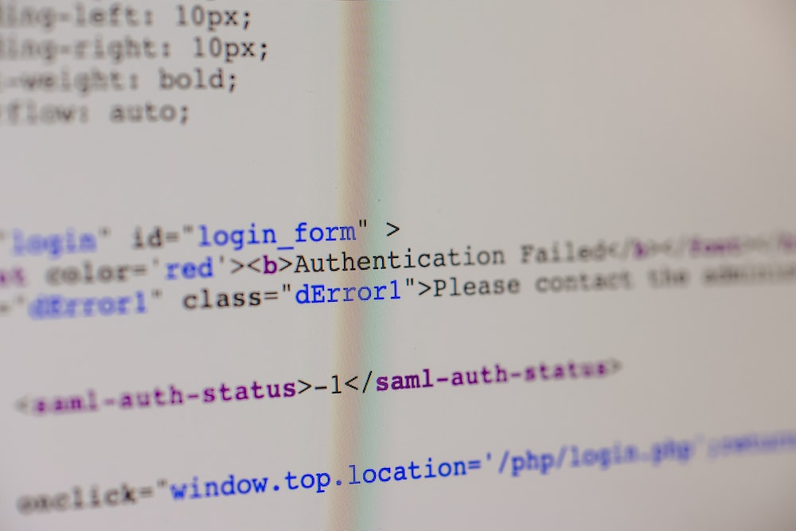
What actually are Open Code and Materials?
“Open Materials and/or Code refer to researcher-created resources used while collecting or analysing data (e.g., survey questions, video stimuli, vignettes, algorithms, coding schemes, analytic code, etc.) that are made openly available to the research community and public” (Barnett et al., forthcoming).
Open Software also comes under this definition, but this isn’t something that we will be addressing in this introductory workshop directly. However, similar principles apply.
Open Source Software is software for which the source code is openly licensed and available for scrutiny, adaption and reuse.
Credit: Markus Spiske

Slide 5


Slide 6
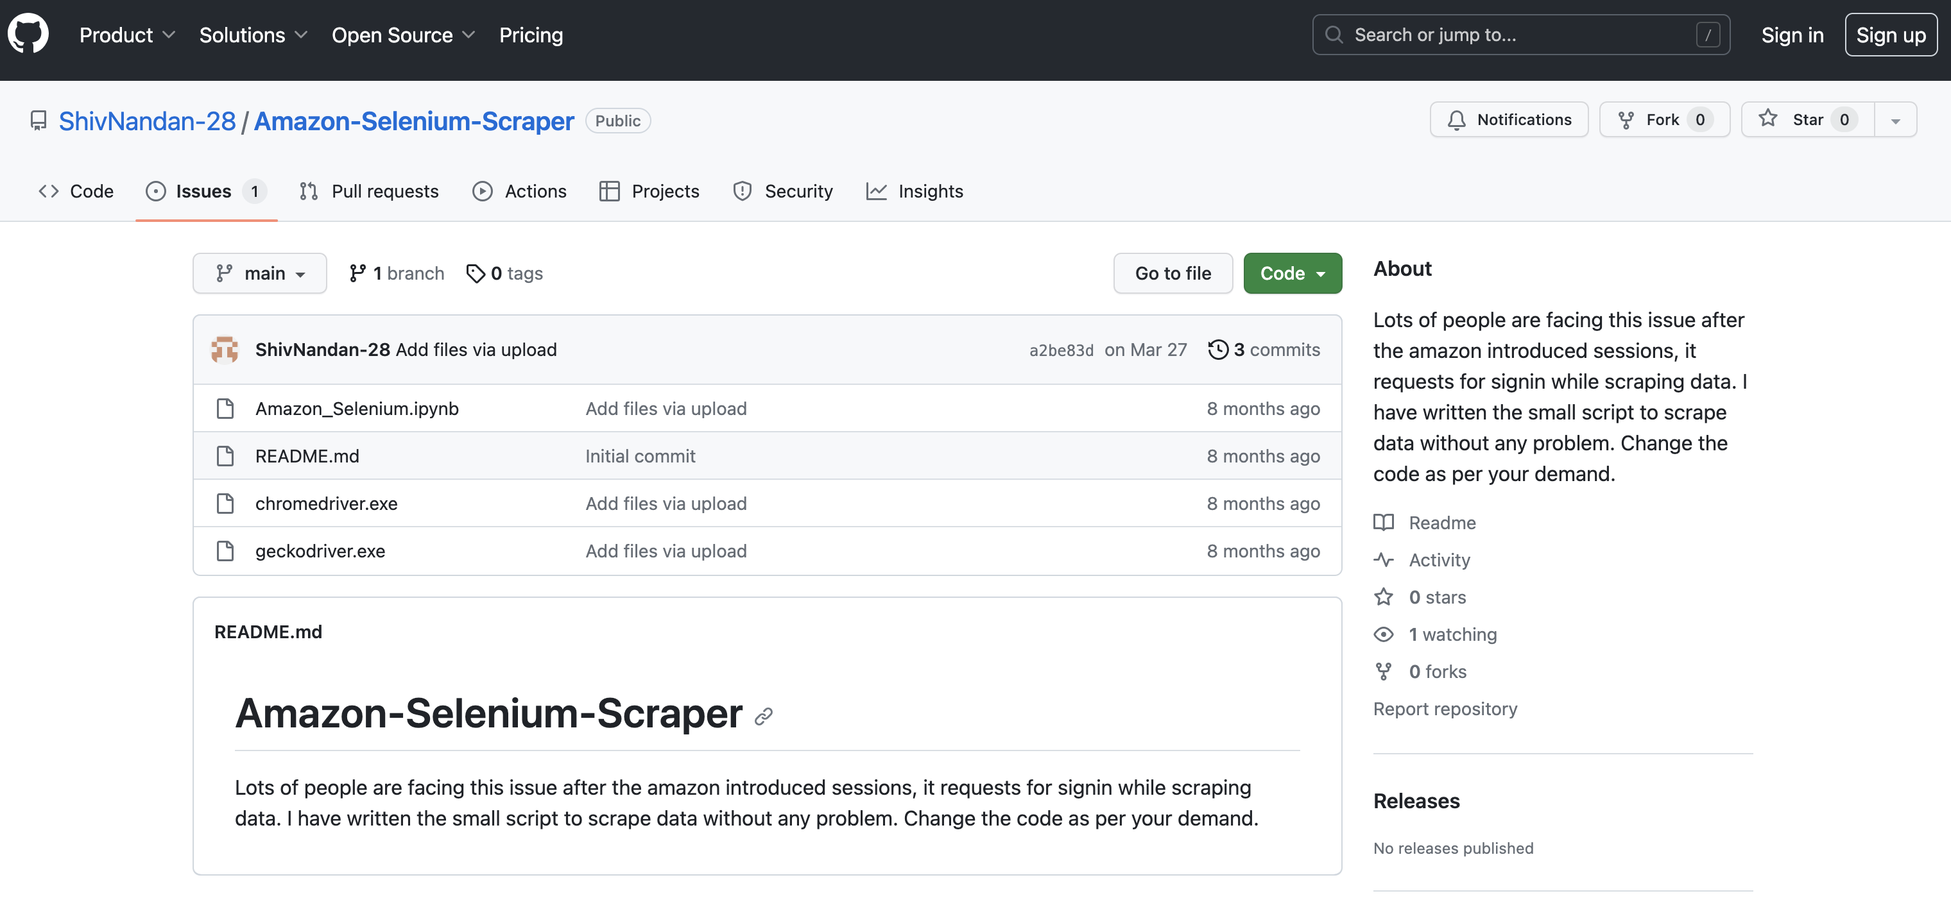
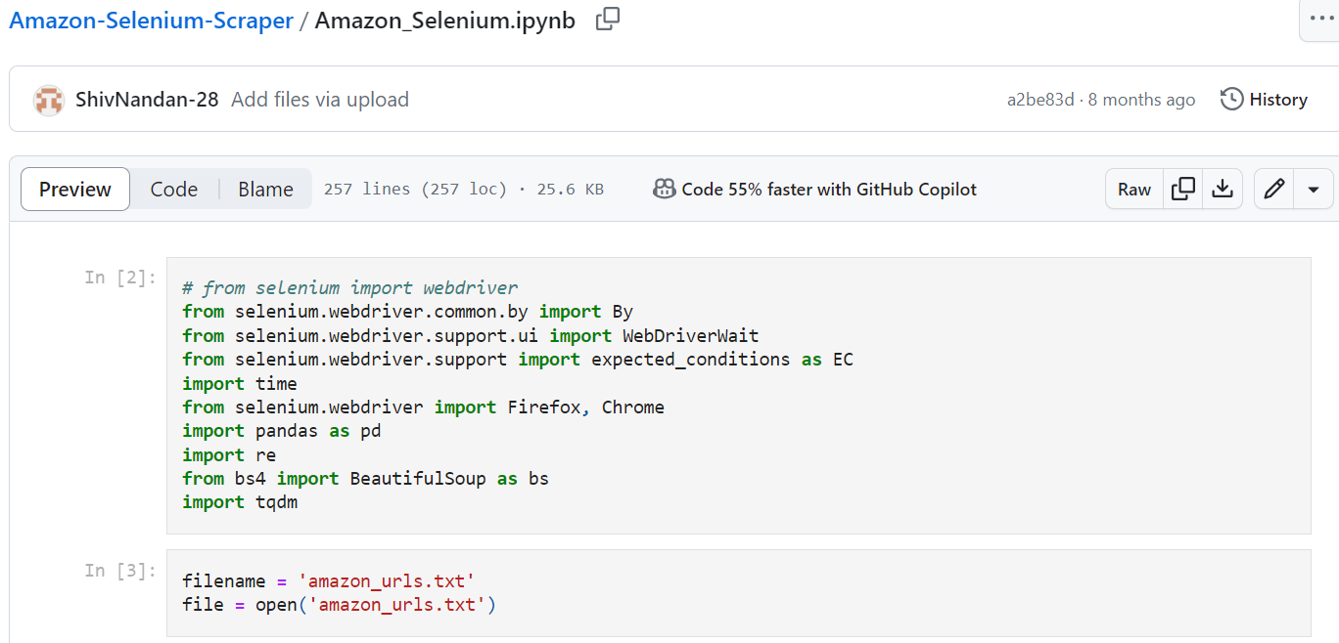
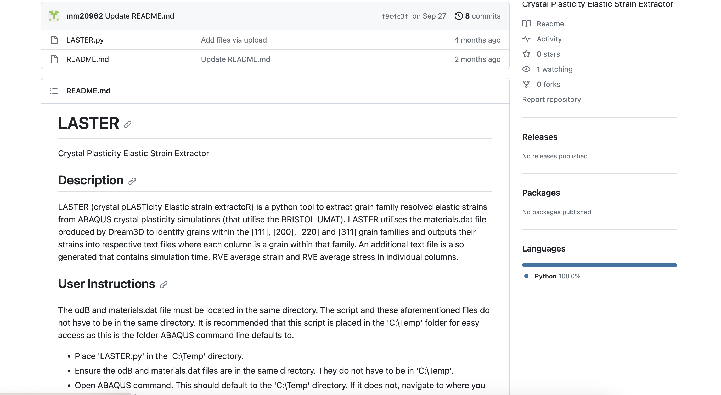
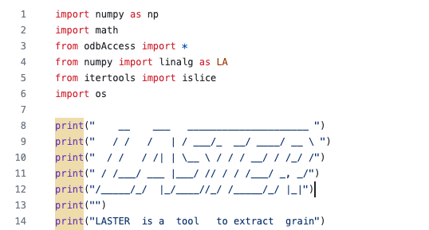
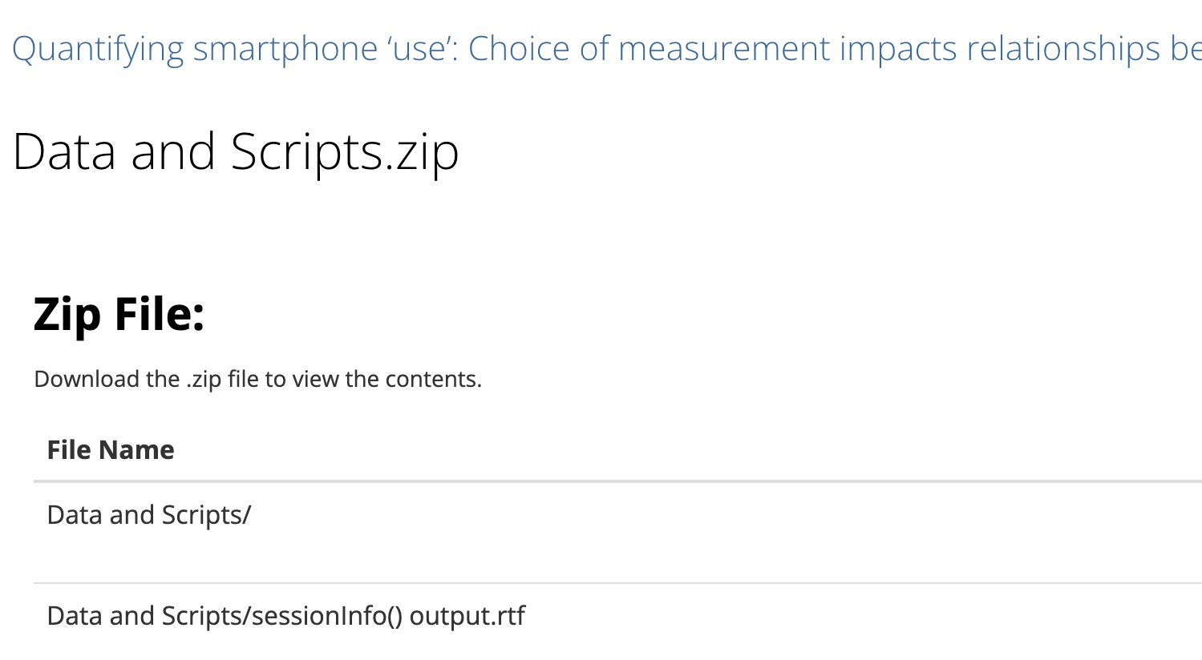
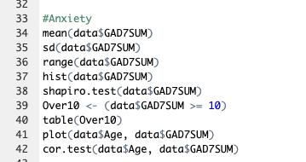
Examples of Open Code
https://github.com/ShivNandan-28/Amazon-Selenium-Scraper
Code can be written and shared for a variety of use cases, such as:
Data collection
Data processing
Data analysis
https://github.com/mm20962/LASTER
https://osf.io/sw38c
Notes:
Add a screenshot of the actual code for each snippet?

Slide 7
Examples of Open Materials
Can you think of any other materials you might share?
Notes:
Source links:
Survey materials: https://osf.io/xnhzq/
Qualitative codebooks: https://osf.io/m58td
Interview guides: not yet shared openly

Slide 8
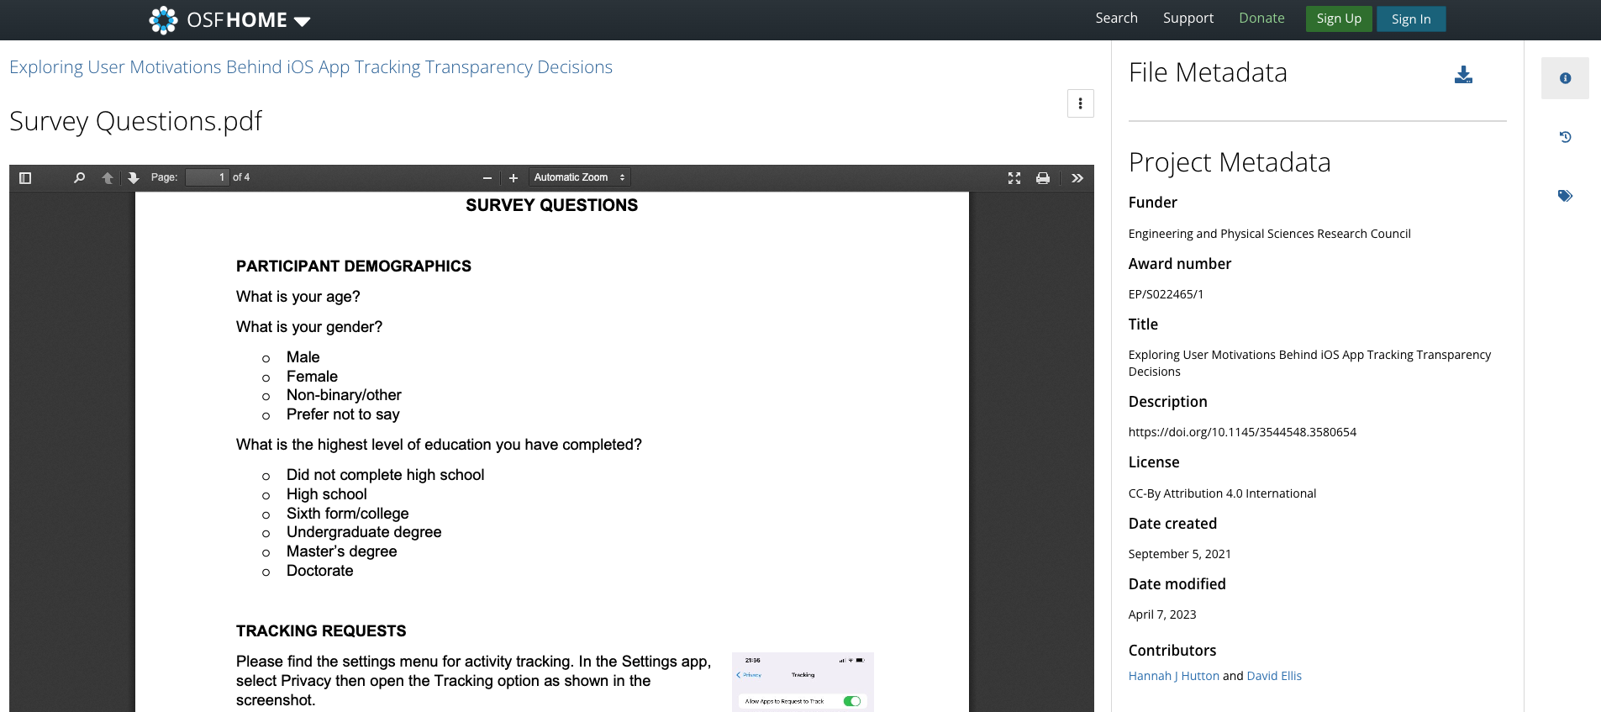
Survey Questions
Source link: https://osf.io/xnhzq/

Slide 9
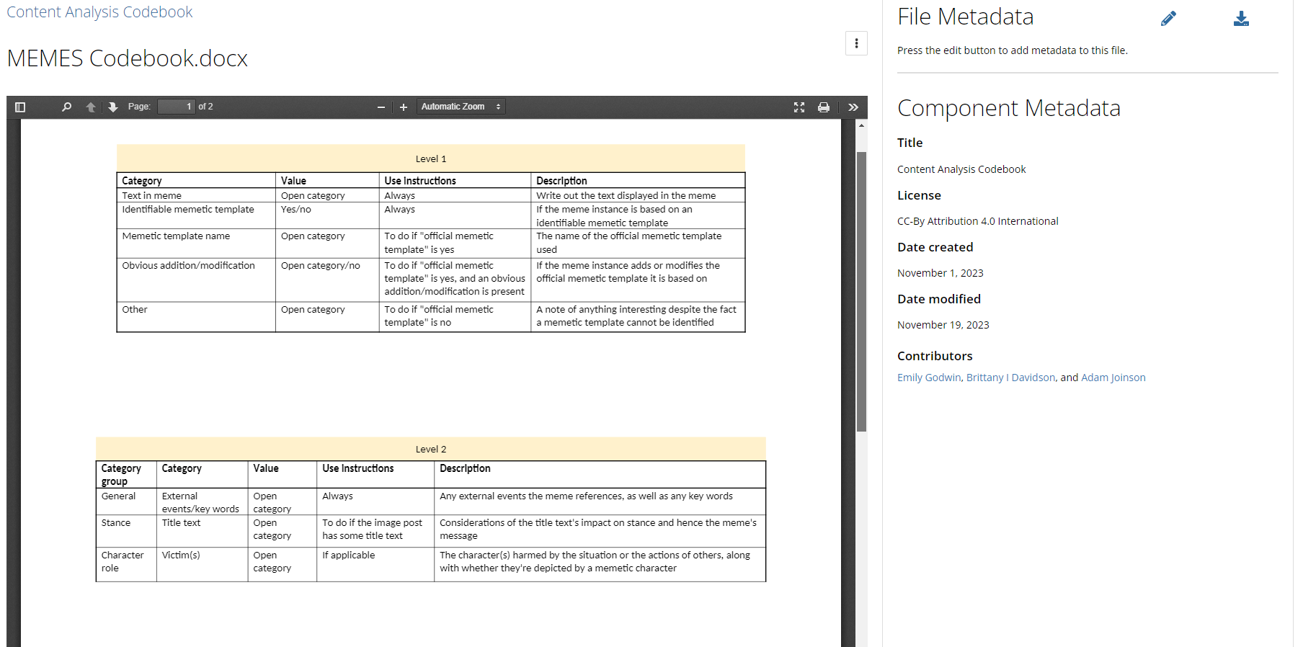
Qualitative Codebooks
Notes:
Emily to add her codebook

Slide 10
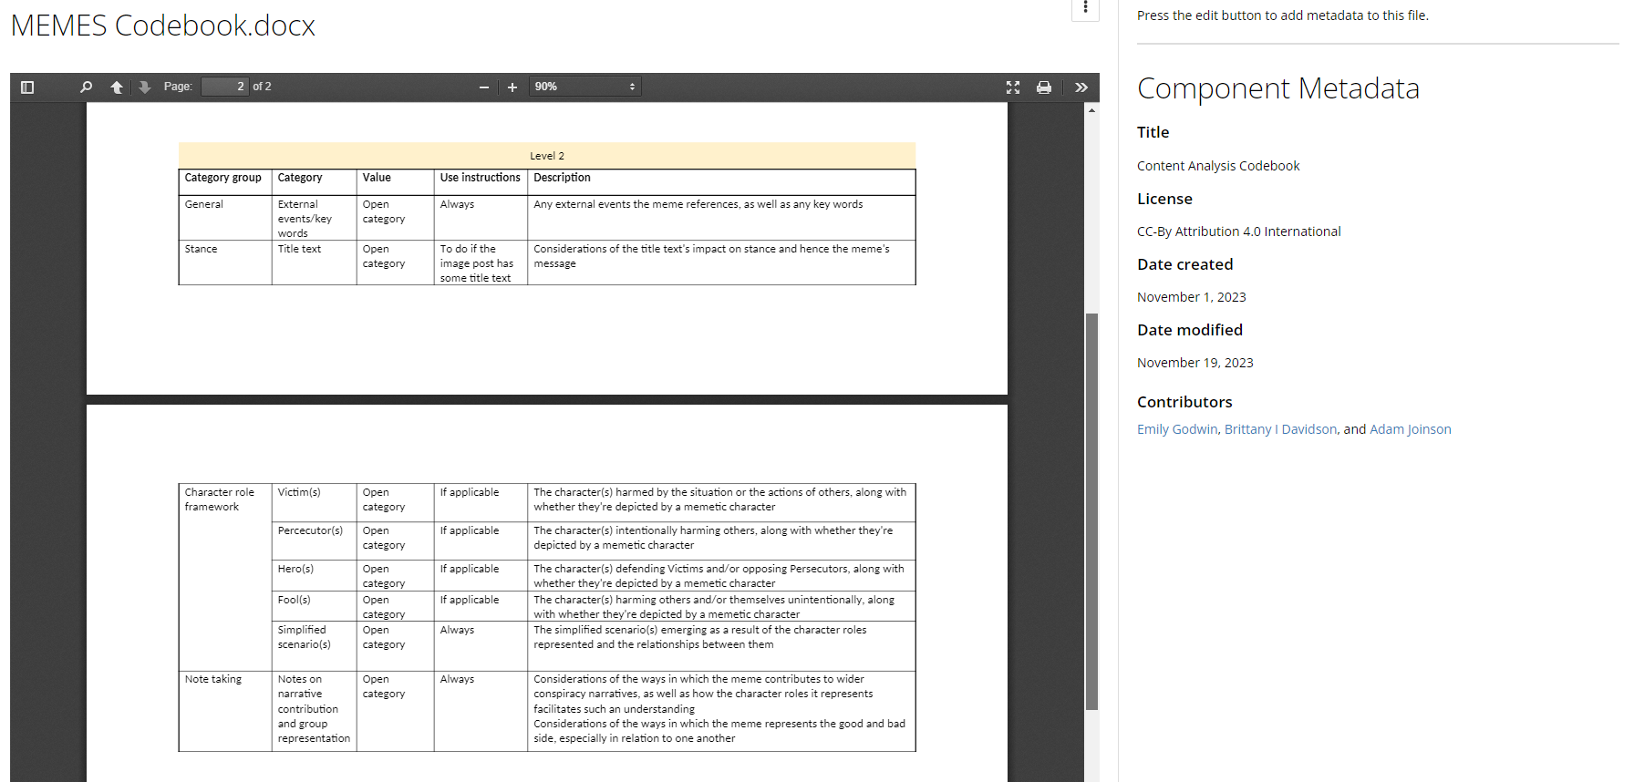
Qualitative Codebooks
Notes:
Emily to add her codebook

Slide 11
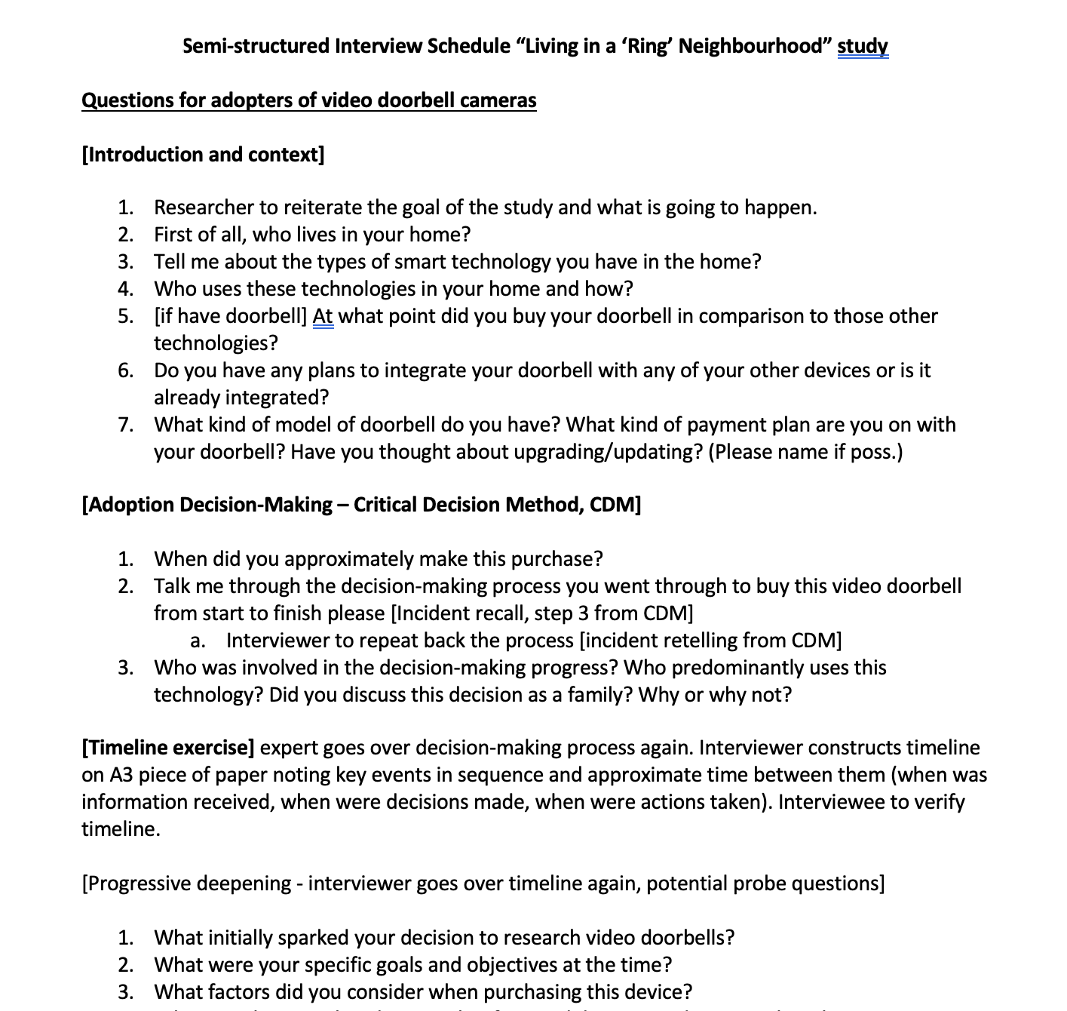
Interview Guides

Slide 12
What are the benefits to sharing code and materials?
Why should you share code and/or your materials? Why not? Can you give examples from your own work?
There are several benefits to sharing your code and materials openly, such as:
Reducing duplication and effort for future research
Improving reproducibility and repeatability
Capturing the work involved in data management
Building your reputation and networks
Teaching and learning opportunities
Enabling the continuity of your work
Improves trust in your work
Notes:
Source link: https://blogs.ucl.ac.uk/open-access/2021/09/14/code-sharing-as-an-ecr/

Slide 13


Slide 14
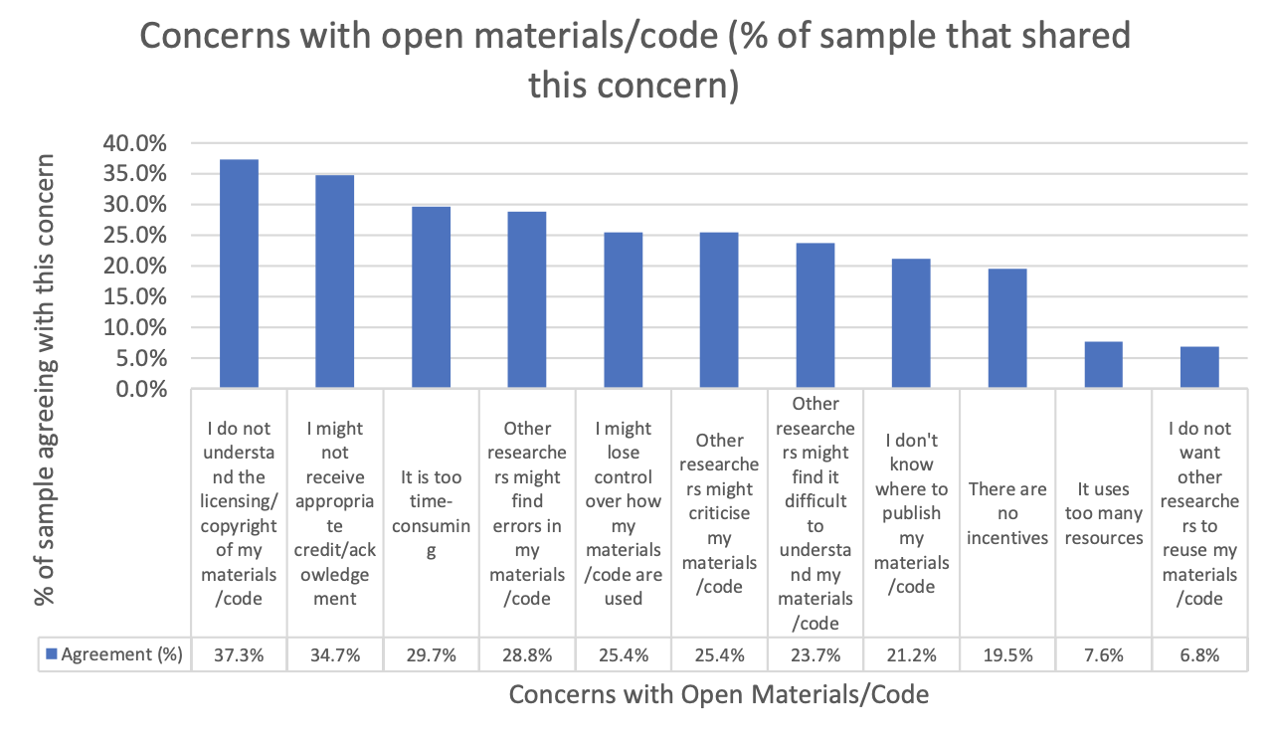
Barriers and concerns with code sharing
Here are some concerns that other Bath researchers have… (Barnett et al., forthcoming).

Slide 15
How to find open code/materials….
Github
OSF
Individual websites or textbooks

Slide 16


Slide 17
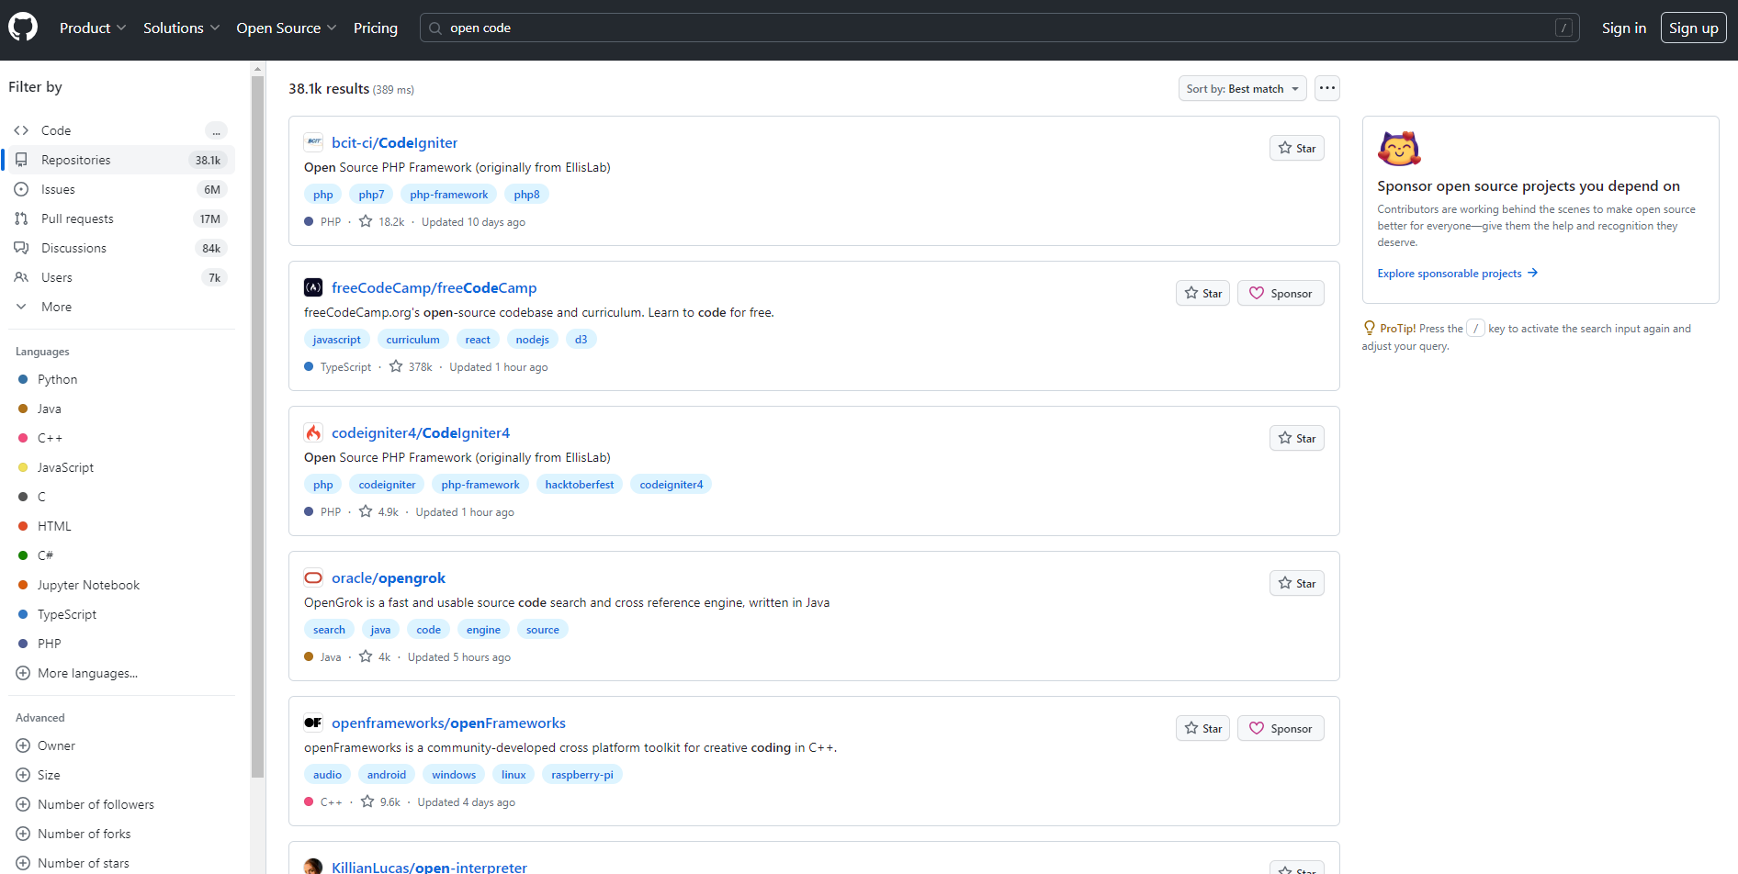

Slide 18
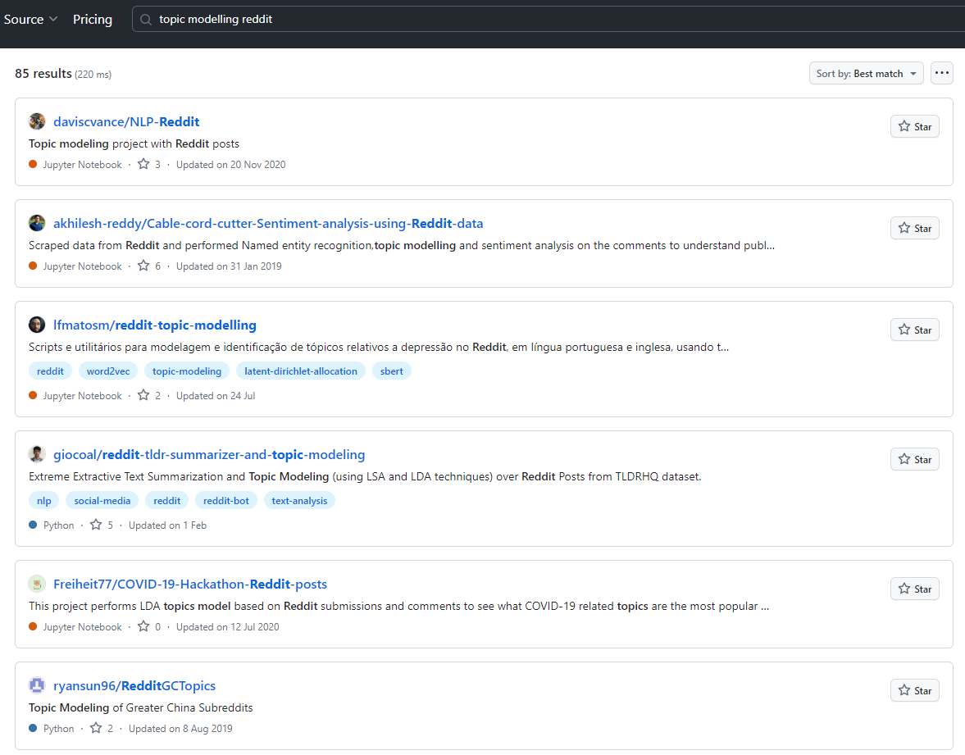
https://github.com/daviscvance/NLP-Reddit

Slide 19
How to find open code/materials….
Github
OSF
Individual websites or textbooks

Slide 20


Slide 21
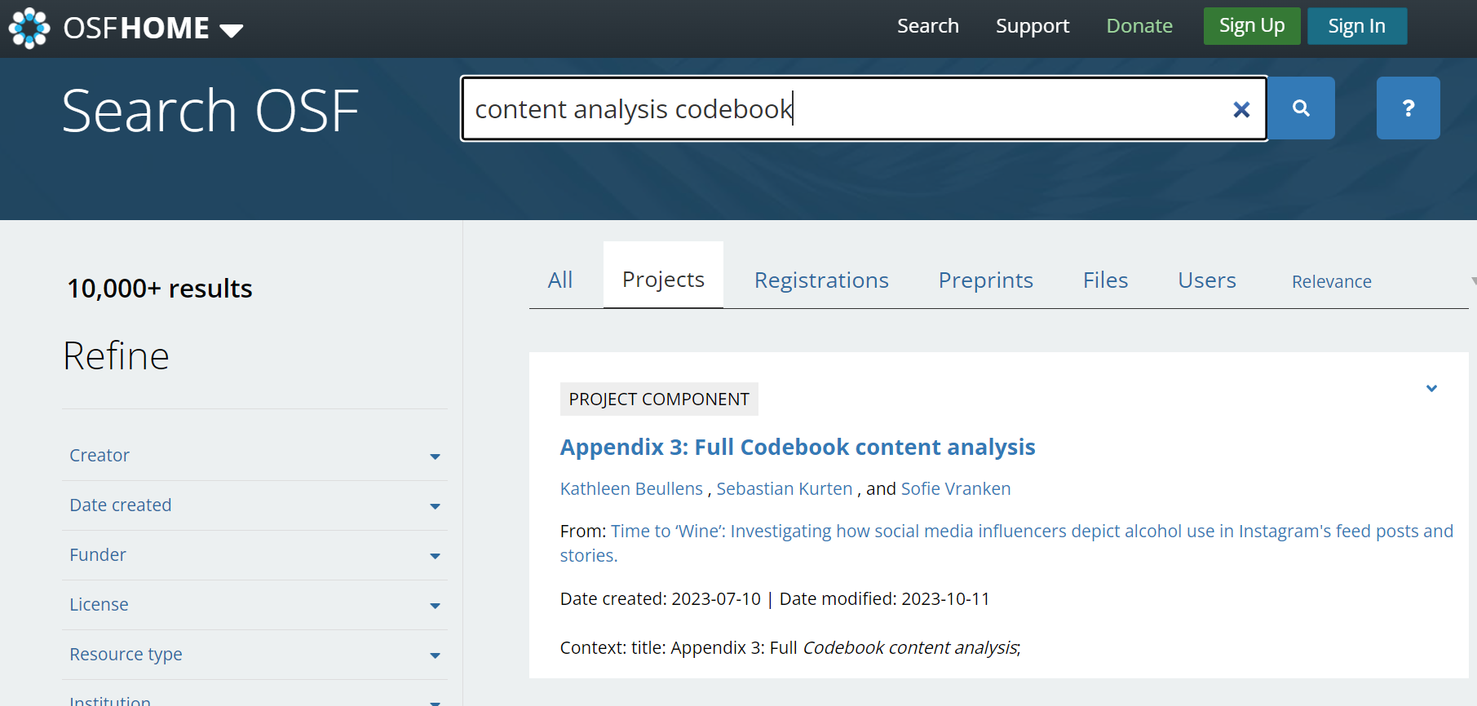

Slide 22
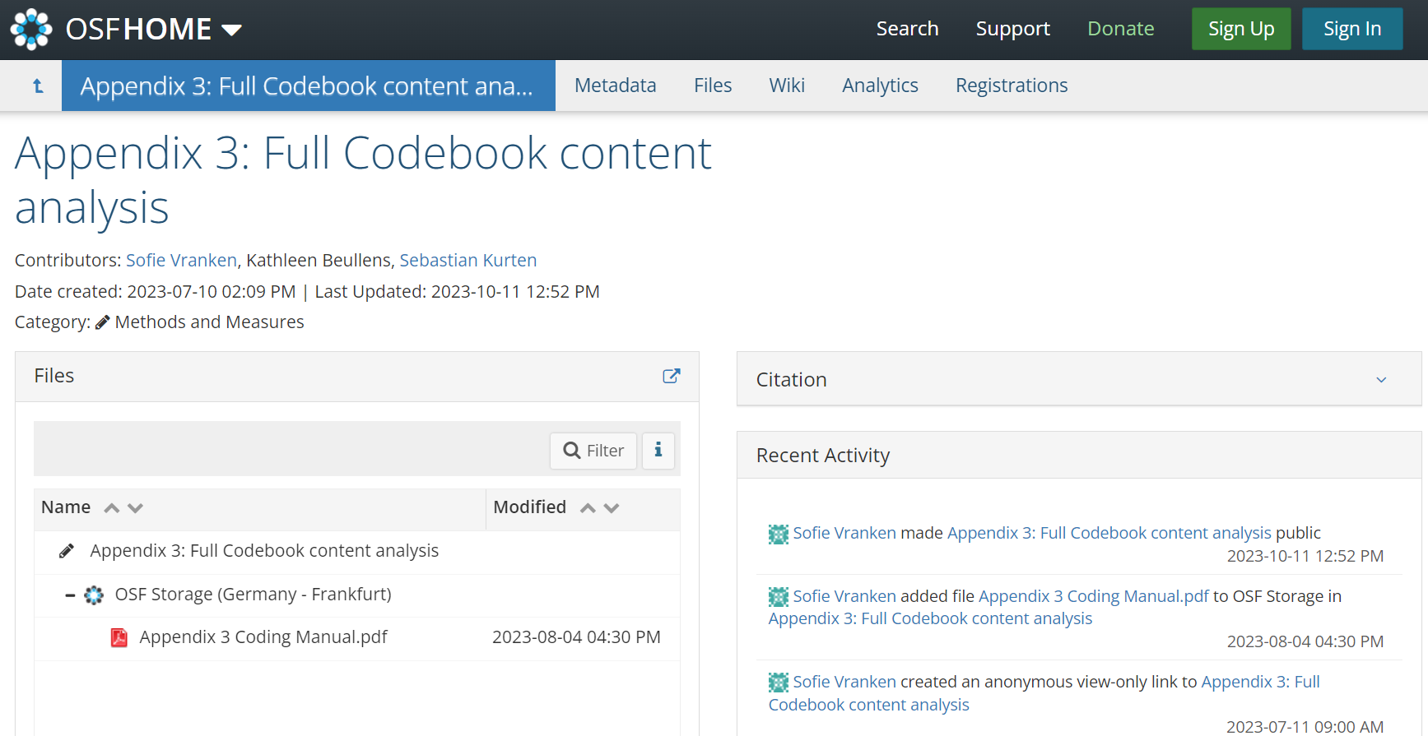

Slide 23
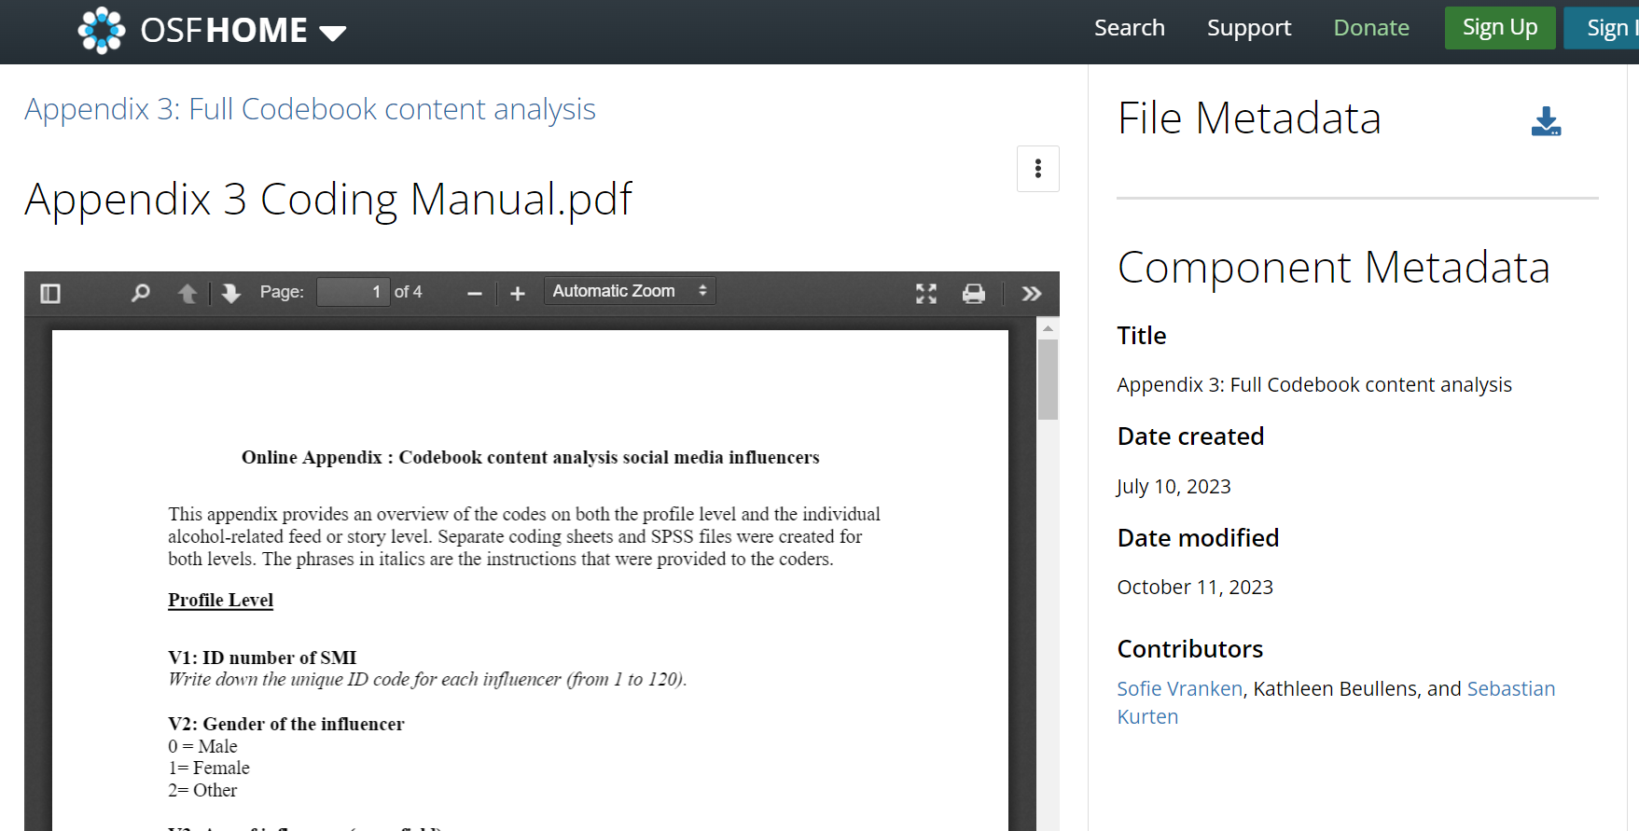
https://osf.io/zuxkw

Slide 24
How to find open code/materials….
Github
OSF
Individual websites or textbooks

Slide 25
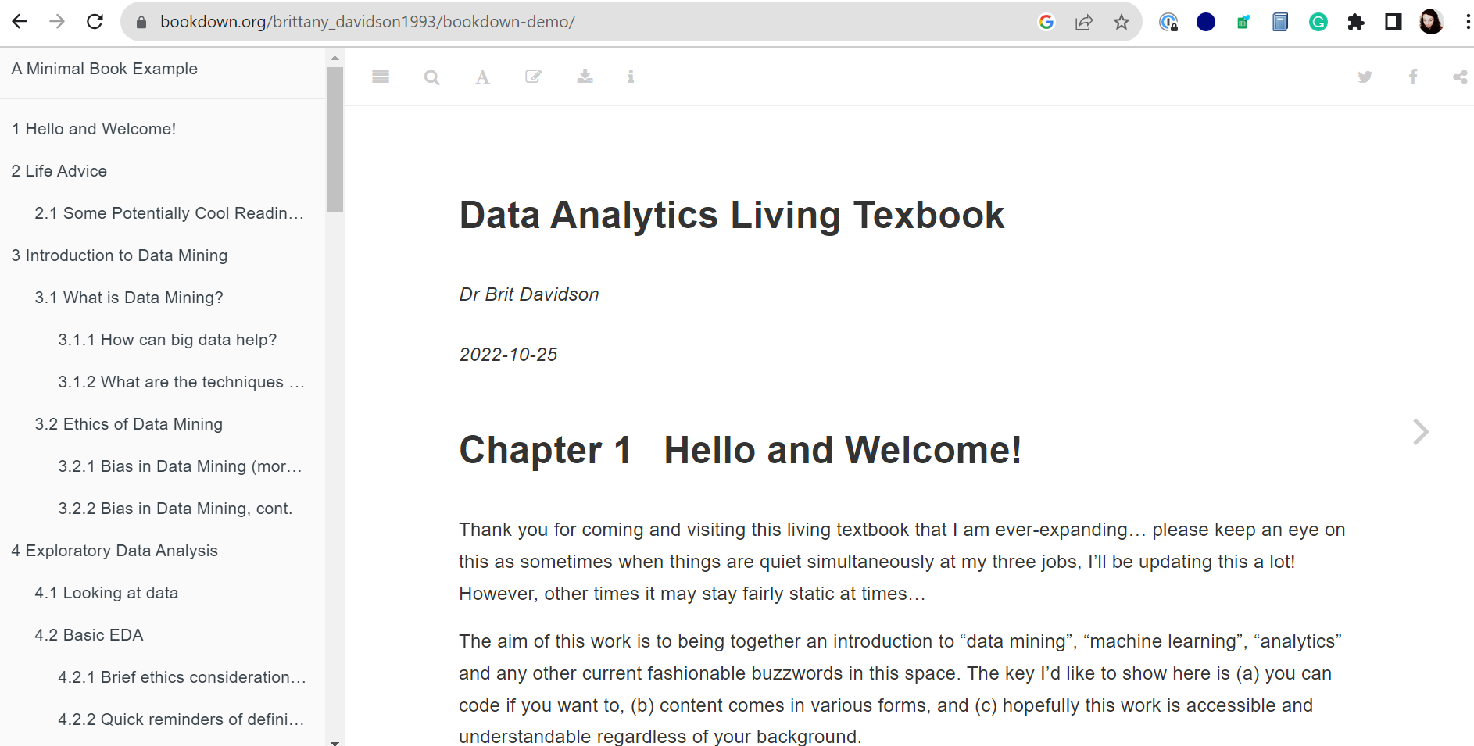

Slide 26
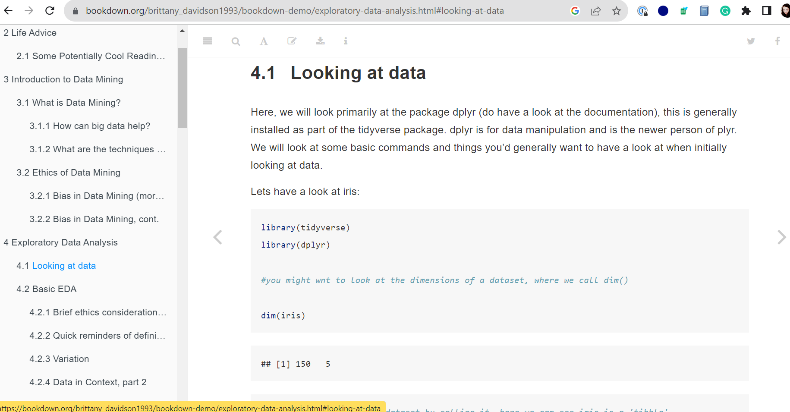
https://bookdown.org/brittany_davidson1993/bookdown-demo/

Slide 27
Activity: Find some Open Code/Materials related to the methodology you’re most interested in…

Slide 28
How to share code and materials… on OSF https://osf.io/
Web based application
Used for general file storage
Project: The primary organisational structure, where all files and information is managed
Component: Subsections of a project that contain their own separate materials, data, files
Wiki: Documentation space for the project, as well as notes
Tags: User-defined keywords or labels that facilitate searching and categorisation
Notes:
Final spot for your files

Slide 29
How to share code and materials… on OSF
Go to https://osf.io/ and create an account
Click Create Project
Select a storage location
Create a file of your choosing (word document, R script etc)
Upload the file to OSF into the main project
Click on OSF Storage and create a folder or upload your file
Create a component
Upload a file into your component

Slide 30
How to share code and materials… on GitHub https://github.com/
Github Desktop
From within R / Python
Via the command prompt
It’s all personal preference!
But first… let’s make a GitHub Account
Go to https://github.com/
Sign Up and follow the steps
Create a test repository
Notes:
Multiple ways of syncing files to github but view files in the web
Version control of files – like onedrive but on steroids. (in onedrive / google drive things get overwritten but github saves individual versions so you can always go back)
[share dessis anecdote here, or my r mishap]

Slide 31
GitHub Glossary https://docs.github.com/en/get-started/quickstart/github-glossary
Repository: The place where your project lives. Can be a local folder on your PC or storage space on GitHub.
Branch: A parallel version of a repository. It is contained within the repository but does not affect the primary or main branch allowing you to work freely without disrupting the "live" version.
Fork: A copy of a repository that is saved to your GitHub account. It allows you to experiment with changes without affecting the original project.
Commit: An individual change to a file (or set of files). When you make a commit to a repository, you're essentially taking a snapshot of your project at that moment in time.
Push: Sending your committed changes to a remote repository on GitHub. It's the counterpart to pull.
Pull: Refers to when you are fetching in changes and merging them. For instance, if someone has edited the remote file you're both working on, you'd pull in those changes to your local copy to keep it up to date.
Merge: Taking the changes from one branch (in the same repository or from a fork) and applying them into another. This often happens as a pull request.
Pull Request (PR): A request to merge your changes into the main branch. It is a way to submit contributions back to the original project.

Slide 32
How to share code and materials… on GitHub Desktop
Download https://desktop.github.com/
Create a new repository (Ctrl + N) – this will set up a local repository
Or clone an online repository (Ctrl + Shift + O) – this will require you to nominate a local repository
Click Publish Repository
Create a file of your choosing (e.g. word document, excel sheet, R script etc) and put a test line into it
Save it in your local repository
In GitHub Desktop, click Commit to main and Push changes
Change something in your file
In GitHub Desktop, click Commit to main and Push changes
Notes:
Overview of GitHub terms?

Slide 33
More resources and places to practice
Git from R
https://happygitwithr.com/connect-intro
Git from python
https://www.pythonguis.com/tutorials/git-github-python/
Git from console
https://product.hubspot.com/blog/git-and-github-tutorial-for-beginners
More on reproducibility (R based textbook)
https://raps-with-r.dev/intro.html
More on branching (interactive website)
https://learngitbranching.js.org/

Slide 34
Conclusion f Open discussion questions: - How do you feel about sharing code and materials? - Will you be sharing resources for your next project? - Any final thoughts?
Notes:
Emily – add Mendi thing to this slide

